Slide 1
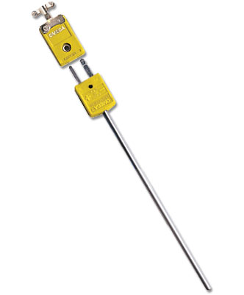
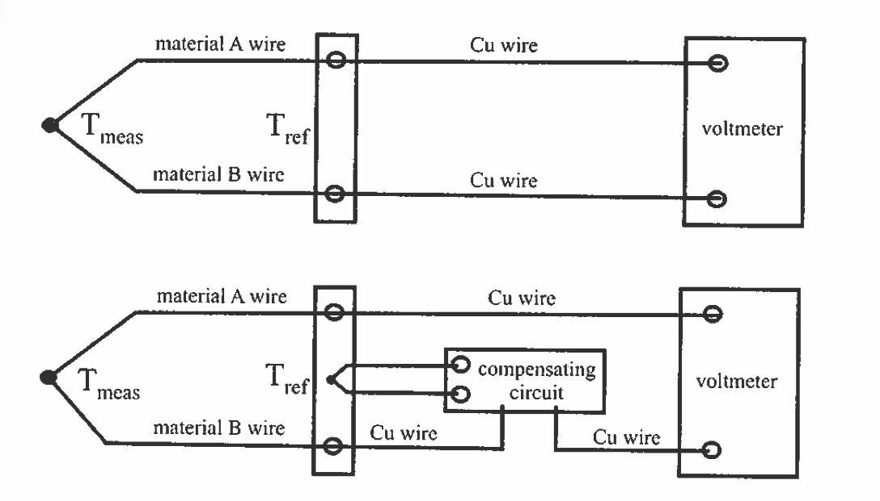

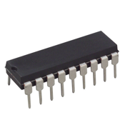
A10 - Thermocouple
Two different metals form a junction – Seebeck or Thermoelectric effect
Thermocouple “type” refers to what metals it uses (Type K, Type J, etc.)
1% accuracy over a wide a temperature range!
Omega.com
Fig. 4.18
IC chip to amplify and linearize the output such that V = (10 mV/C)*T

Slide 2
A10 - 1st Order Response
Thermocouple (TC)
“1st order response”
Response to an “impulse”

Slide 3
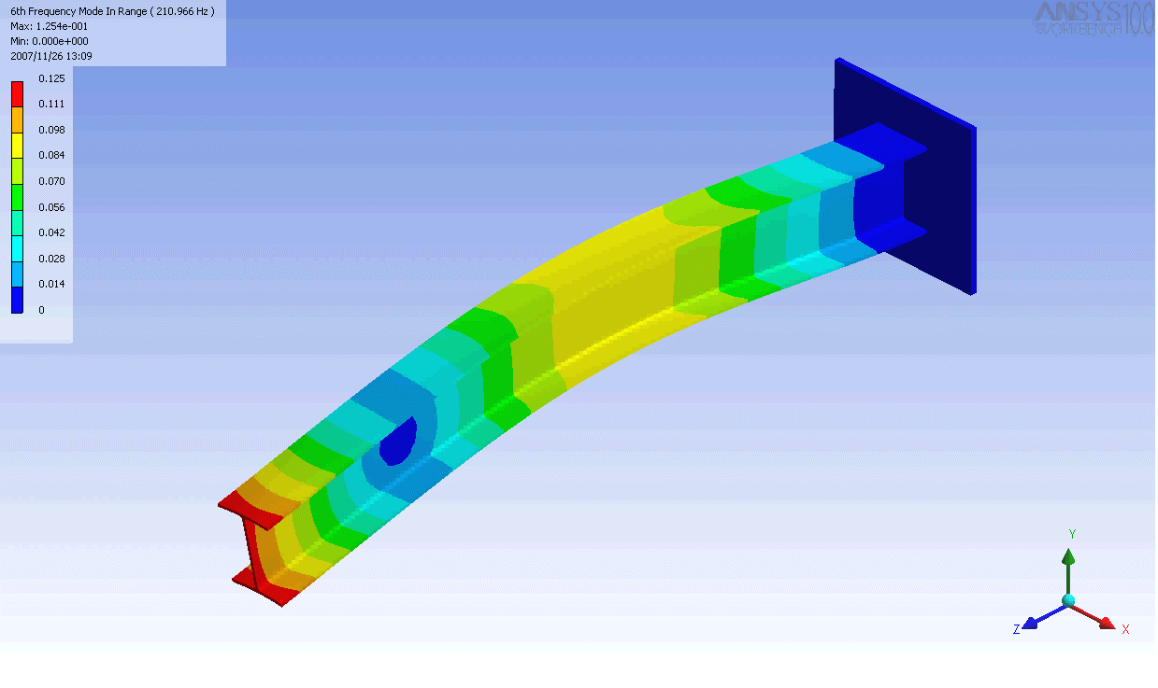

A10 - Cantilever Vibrations
Baseball bat undergoes cantilever vibrations after striking a ball.

Slide 4
Fourier Transform
AMPLITUDE vs. FREQUENCY
AMPLITUDE vs. TIME
FFT
PHASE vs. FREQUENCY

Slide 5
Fourier Transform
Gives us the amplitudes of the Fourier modes.
Contains information about amplitude and phase:
Amplitude:
Phase:

Slide 6
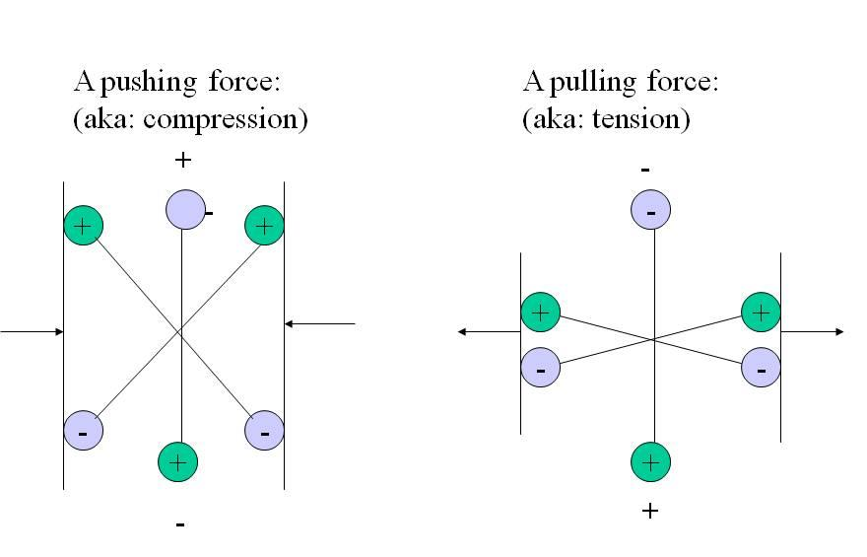
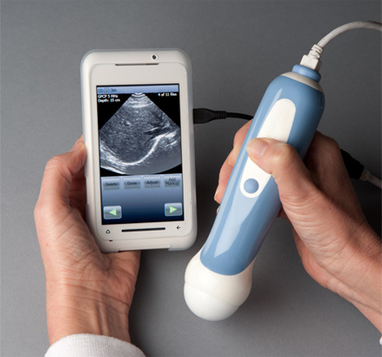
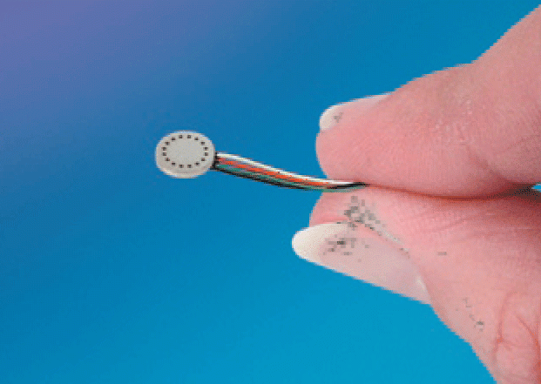
A10 - Piezoelectric Pressure Transducer
Piezoelectric crystals produce a voltage when deformed
voltage
Pressure
+
+
+
+
-
-
-
-
Kulite Sensors - DC
Ultrasound - AC

Slide 7
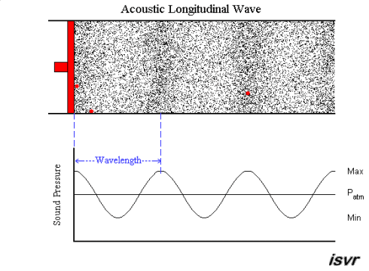
Acoustic Waves
Fluctuations in pressure and density propagate through the air at the speed of sound.

Slide 8
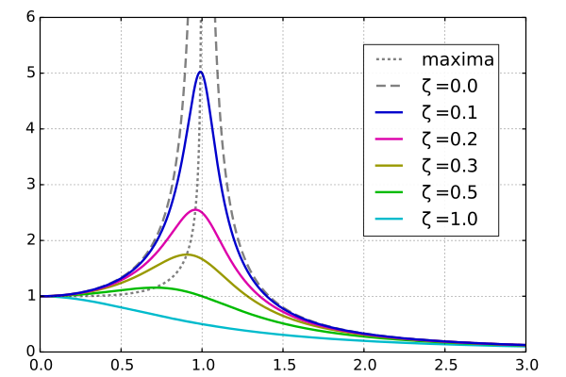
A10 - 2nd Order Response
Driven response, amplitude vs. freq.
ω/ω₀

Slide 9
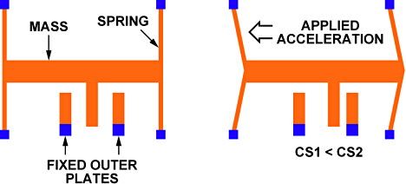
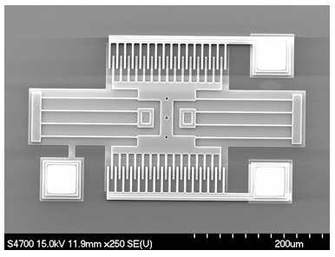
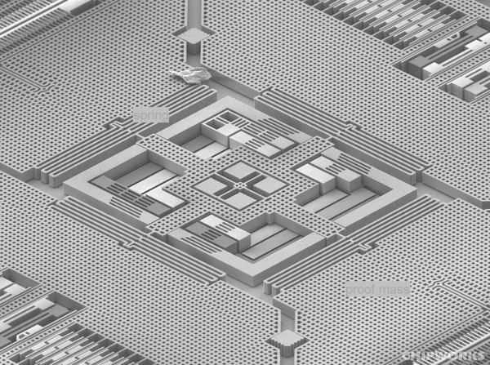
MEMS Accelerometers
Acceleration causes mass to push on spring and displace the “interdigitated” electrodes,
changes electric capacitance.
Micro-Electro-Mechanical Systems (MEMS)
3-axis gyro from an iPhone 4

Slide 10
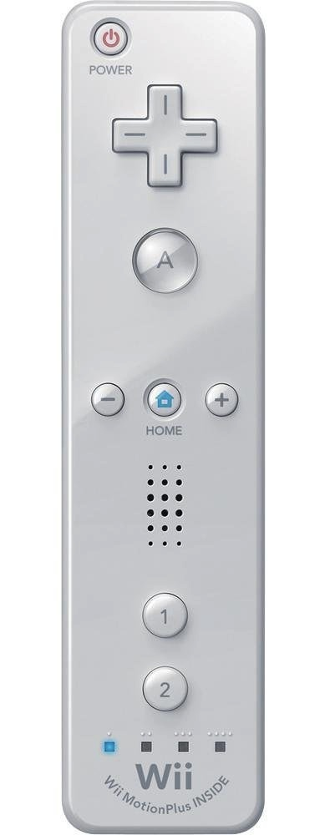

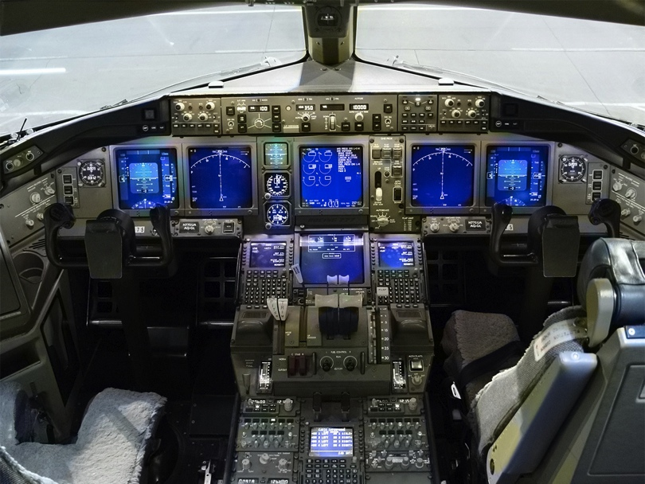
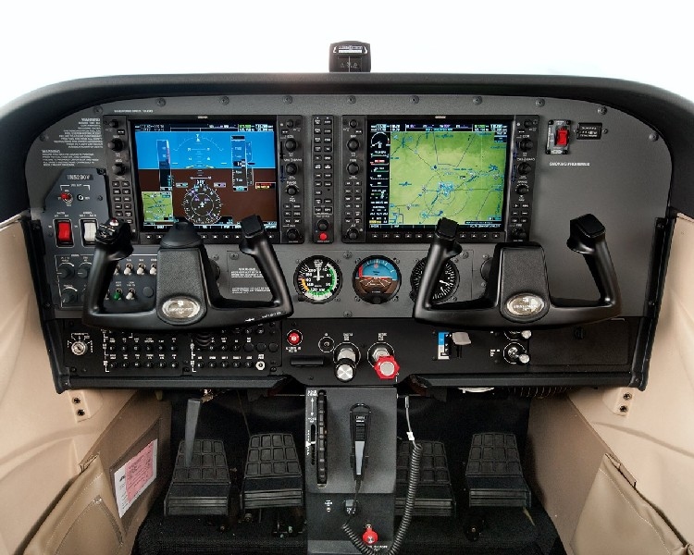
Accelerometers
Boeing 777 glass cockpit.

Slide 11
Quadrature Encoders
A Quadrature encoder counts electrical pulses as slotted wheel passes through a photocell.
Measures angular position and speed.

Slide 12
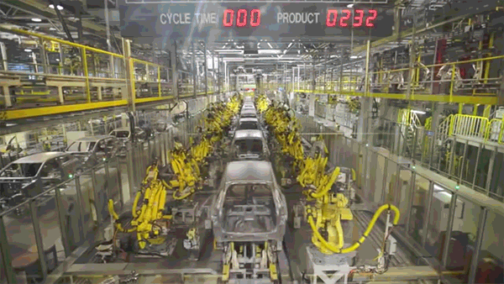
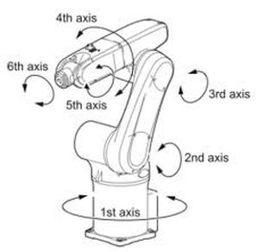
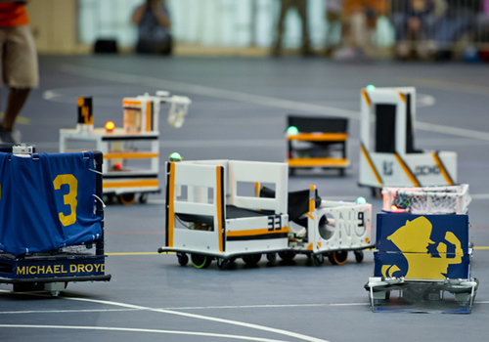
Orientation
Mechanical parts can rotate to various angles.
Robot football

Slide 13
Single pendulum: Predictable motion
Behaves as a damped harmonic oscillator.

Slide 14
Double pendulum: Chaotic motion
Motion in unpredictable and impossible to repeat.

